Slide 1
Abhima Sri Koppera
Final Project
3/21/2024 Annual Review

Slide 2
KeyLogger&Security
Keyloggers are malicious software designed to record keystrokes, capturing sensitive information such as passwords and personal data. They pose significant security risks by potentially transmitting this information to unauthorized parties. Effective protection includes using updated antivirus software, enabling two-factor authentication, and being cautious about downloading and installing software from untrusted sources.
Hardware Keyloggers: These are physical devices that are plugged into the keyboard or installed within the computer's hardware. They capture keystrokes directly from the keyboard.
Software Keyloggers: These are programs that run silently in the background, recording keystrokes and sending the captured data to an attacker. They can be installed through malicious downloads, phishing emails, or exploit vulnerabilities in software.
3/21/2024 Annual Review

Slide 3


AGENDA
Problem statement
Project overview
Who are the end users?
Solution and its value proposition
The wow in your solution
Modelling
Results
Project Link
3/21/2024 Annual Review

Slide 4

PROBLEM STATEMENT
The increasing prevalence of keyloggers poses a significant threat to digital security by covertly recording keystrokes and capturing sensitive information such as passwords, credit card numbers, and personal identification details. These malicious programs can lead to unauthorized access to personal and financial accounts, resulting in identity theft, financial loss, and privacy breaches.
The challenge is to develop robust and proactive security measures that can detect, prevent, and mitigate the impact of keyloggers, ensuring the protection of users' data and maintaining the integrity of digital systems. This involves a combination of advanced detection algorithms, user education, and secure software practices to create a comprehensive defense against keylogging attacks.
3/21/2024 Annual Review

Slide 5

PROJECT OVERVIEW
Objective:
Develop solutions to identify, mitigate, and prevent keylogger attacks, protecting sensitive information.
Key Components:
Detection Mechanisms: Enhance antivirus software, use machine learning for behavioral analysis, and detect hardware keyloggers.
Preventive Measures: Regular software updates, firewall configurations, and secure authentication with 2FA and password managers.
User Education: Conduct training programs and awareness campaigns on phishing and safe practices.
Response Protocols: Implement incident response plans, continuous monitoring, and regular security audits.
3/21/2024 Annual Review

Slide 6

WHO ARE THE END USERS?
Cybercriminals: The primary end users, using keyloggers to steal sensitive information such as login credentials, credit card numbers, and personal data for financial gain or identity theft.
Industrial Spies: Individuals or entities using keyloggers to gather confidential business information, trade secrets, and competitive intelligence from rival companies.
Disgruntled Employees: Employees who may use keyloggers to collect sensitive information from their employers for sabotage, theft, or personal revenge.
Governments and Intelligence Agencies: Entities using keyloggers for surveillance and intelligence gathering on individuals or groups of interest, both domestically and internationally.
Private Investigators: Individuals who might use keyloggers in investigations to monitor and gather evidence on suspects, often in cases of fraud, infidelity, or other personal matters.
3/21/2024 Annual Review

Slide 7

YOUR SOLUTION AND ITS VALUE PROPOSITION
The Keylogger Detection and Prevention Project offers a comprehensive security framework designed to detect, prevent, and respond to keylogger threats. The solution encompasses the following components:
Enhanced Detection Mechanisms:
Advanced Encryption Techniques
User Behavioral Analysis Tools
Hardware Scanning Tools
Real-Time Keylogger Detection: Implement advanced machine learning algorithms to analyze keystroke patterns and detect suspicious behavior indicative of keylogger activity in real-time.
Anti-Keylogging Encryption: Provide real-time encryption of keystrokes from the keyboard to the application, rendering any captured keystrokes unintelligible to the keylogger.
3/21/2024 Annual Review

Slide 8

THE WOW IN YOUR SOLUTION
1. User-Friendly Interface with Detailed Analytics:
WOW: A sleek, intuitive dashboard that not only alerts users to threats but also educates them on potential vulnerabilities and how to avoid them.
Value: Empowers users with knowledge and control, making security accessible and comprehensible even for non-technical individuals.
2. Multi-Layered Encryption Protocols:
WOW: Implement advanced encryption techniques like homomorphic encryption and attribute-based encryption to protect sensitive data even if intercepted by keyloggers.
Value: Ensures data remains secure under multiple scenarios, significantly reducing the risk of data breaches.
3. Cross-Platform Compatibility:
WOW: Ensure the solution is compatible across various operating systems and devices, providing seamless protection in diverse IT environments.
Value: Offers flexible and consistent security, catering to a wide range of users and organizational setups.
3/21/2024 Annual Review
8

Slide 9
MODELLING
Machine Learning-Based Behavioral Analysis:
Data Collection: Aggregates data on normal user behaviors and keylogger patterns from keystroke dynamics, application usage, and network traffic.
Feature Extraction: Identifies key features such as typing speed, unusual key sequences, and unexpected application behaviors.
Model Training: Utilizes machine learning algorithms like anomaly detection and neural networks trained on the extracted features to differentiate between normal and suspicious activities.
Real-Time Monitoring: Deploys these models to continuously monitor user activities, flagging anomalies that indicate potential keylogger presence.
Signature-Based Detection:
Signature Database: Maintains an updated database of known keylogger signatures, including patterns and code snippets.
Scanning Tools: Develops and utilizes tools to scan systems for these known signatures, both in software and hardware components.
3/21/2024 Annual Review
9

Slide 10
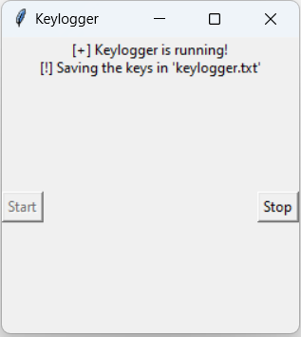
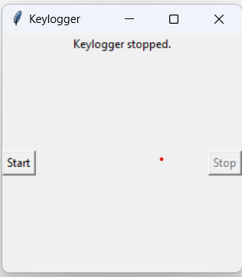

RESULTS
3/21/2024 Annual Review
10

Slide 11
Project link
https://github.com/abhimakoppera/IBMskillsbuildproject.git

